Slide 1
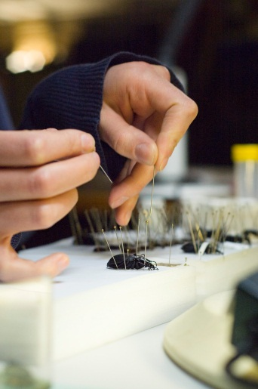
Insect specimens, collections & records
Francisca Sconce
fran@royensoc.co.uk
@FranciscaSconce
www.royensoc.co.uk

Slide 2
Agenda
Talk ~30 min
Importance of collections
Preservation methods
Labelling & data
Storage, cataloguing, digitizing
Biological recording

Slide 3
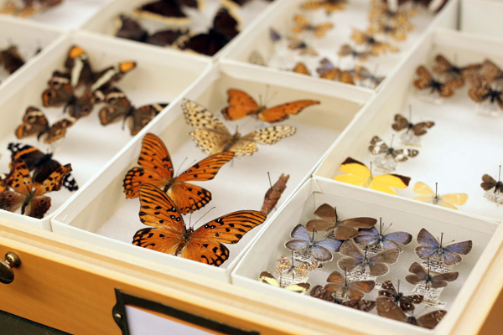
Why do we prepare specimens?
Why?

Slide 4
Why? It doesn’t just look pretty!
Learn about insect anatomy & taxonomy.
Preserve an insect & to identify it.
Biological & genetic record.
Environmental DNA (eDNA).
Intraspecific variation.
See JCCBI codes for collecting 2002, 2010, & 2014

Slide 5
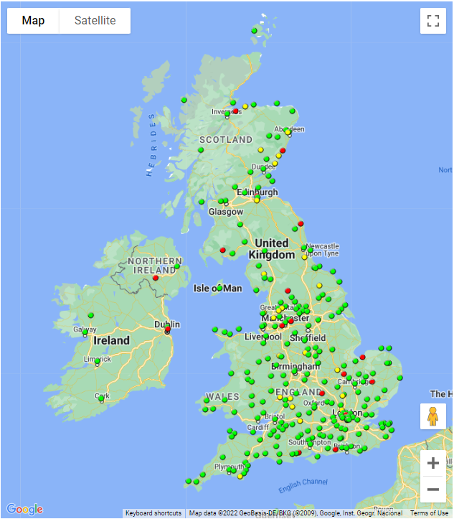
UK Entomological Collections
NHM, London
34 million insects & arachnids
OUMNH, Oxford
3.5 million specimens
Many smaller city & county collections
Map is from NATSCA

Slide 6


Collection ‘Societies’
Natural Sciences Collections Association (NatSCA) UK based
Includes Insect Collections Managers Group [ICMG]
www.natsca.org
Entomological Collections Network
(ECN) International
ecnweb.net

Slide 7
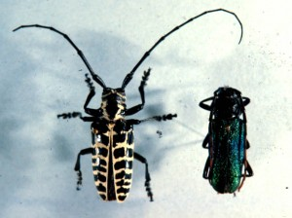
Time, Effort and Space
Perfection takes time, have to compromise!
Style influences space specimens take up, ideally you want to use minimal space.
Different taxa/sizes need different treatment: pinning, carding, pointing, slide preparation.
Ask project supervisor / see coursework brief.

Slide 8
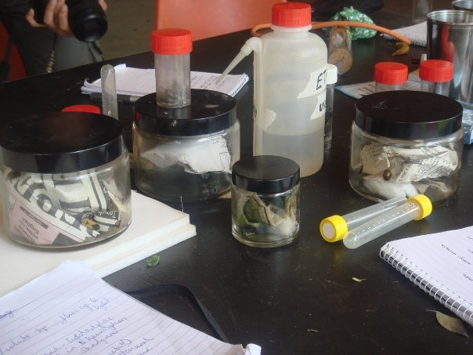
Killing
Freezing, or flash freezing with liquid N (best for genome sampling)
Dunk in Alcohol /Industrial methylated spirits (IMS).
‘Killing jar’ Ethyl acetate or acetone drops on chalk/sand, paper on top with specimens.
Ideally prepare soon after killing.

Slide 9
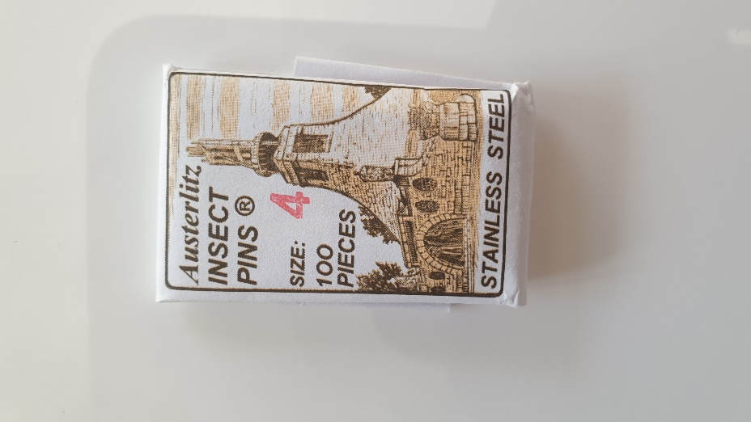
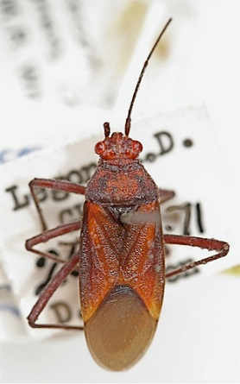
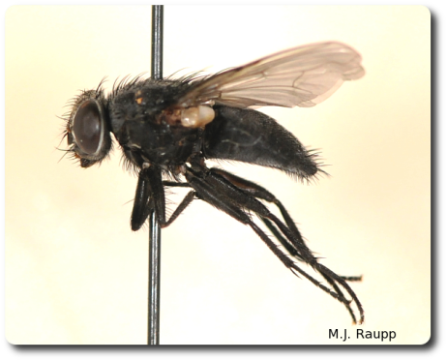
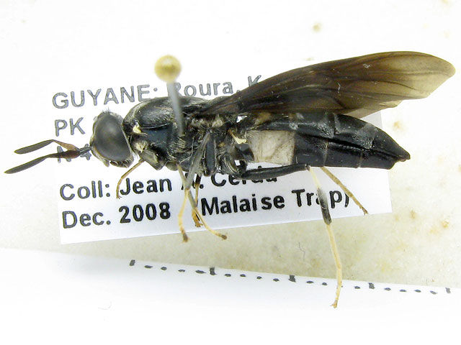
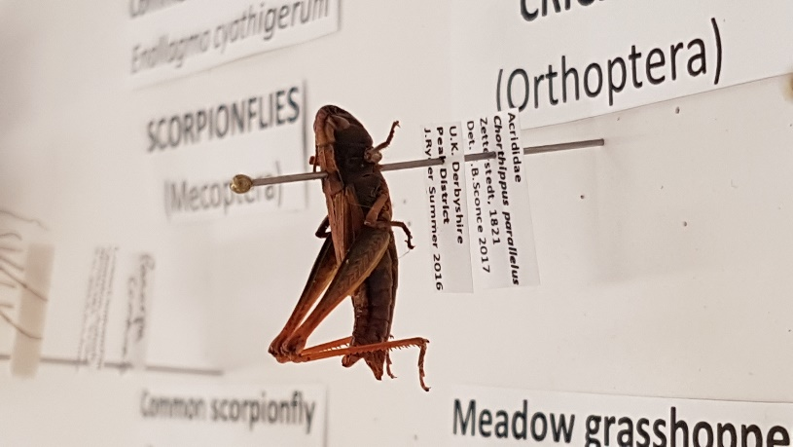
Direct - Pinning
Gold nylon-top Austerlitz ‘Continental’ stainless steel pins, use largest you can, if you need below size 3 then don’t direct-pin.
Pin goes through top right hand thorax/scutellum area, middle thorax for Lepidoptera, right of middle for Hymenoptera.
Brace pins (cheap ones) then used to secure legs in place, remove these when insect has dried out and set.

Slide 10
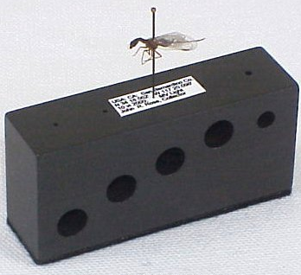
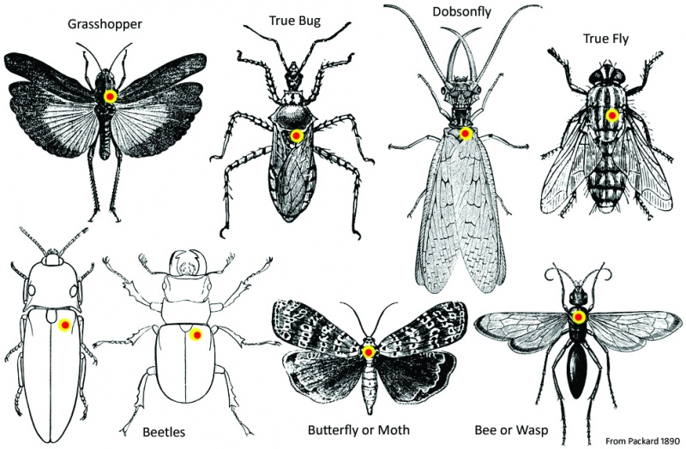
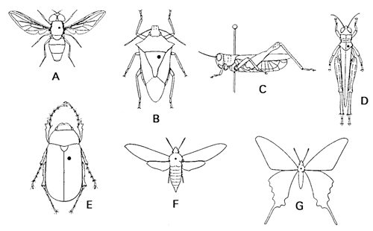
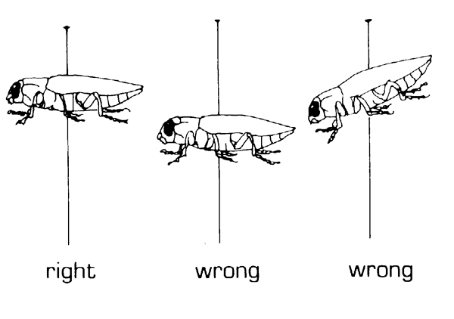
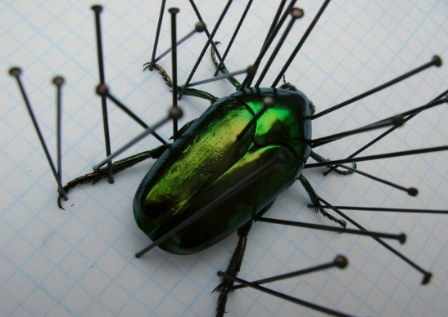
Pin positioning

Slide 11
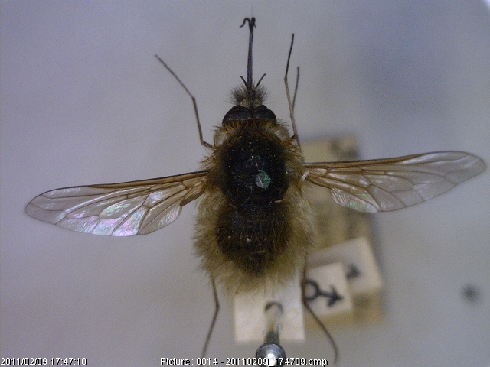
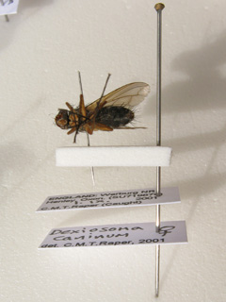
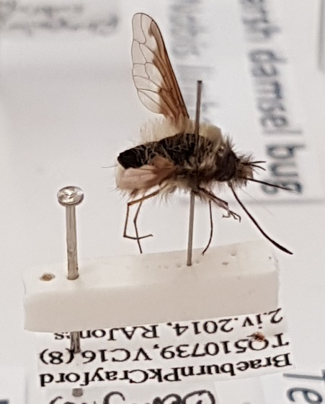
Micro-pinning
For small specimens, use size c / d ‘headless’ pins.
Micro-pin goes through same place in thorax as with large, use brace pins if needed and leave to dry.
Micro-pin then goes on foam stage, which is attached to large pin (size 3 / 4), labels below.

Slide 12
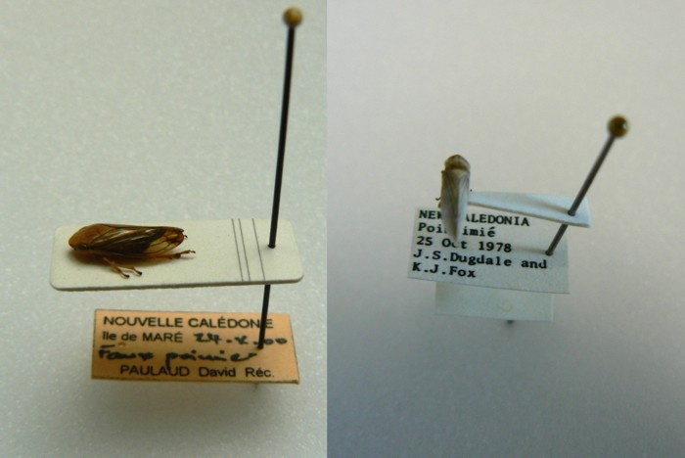
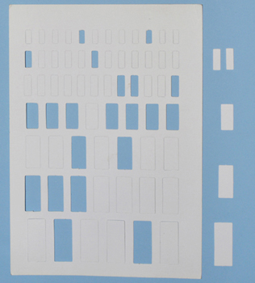
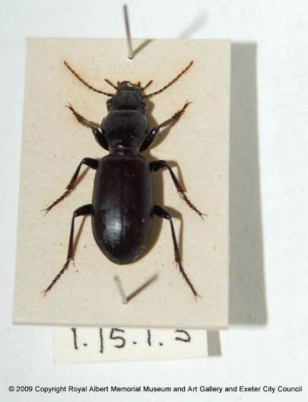
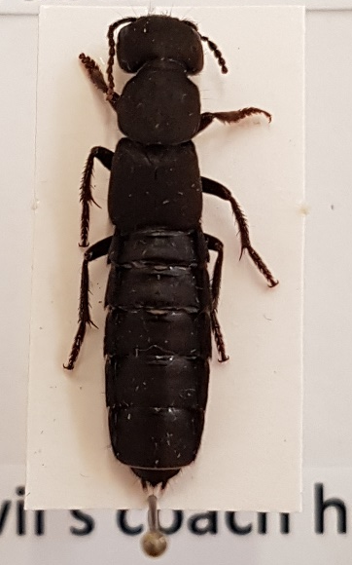
Carding
Range of sizes, preserves specimen legs, but covers part of body.
Gum traganth or seccotine to glue insect onto die-cut cards, large pin (3 / 4) through end of card, labels below.
Usually ventral side on card, position & glue legs & antennae symmetrically.

Slide 13
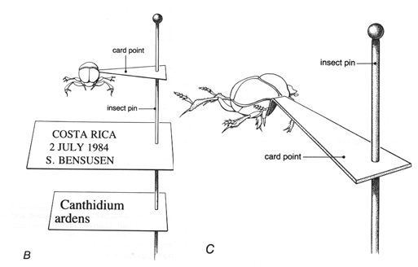
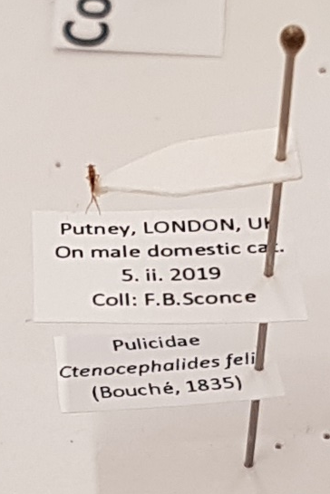
Pointing
Point is a long triangle of card
Good for smaller specimens, can see the whole body, but needs to be securely glued onto the point.
Bend tip, then glue between front & mid legs on righthand underside of thorax. Large pin (3 / 4) at base of card, labels below.

Slide 14
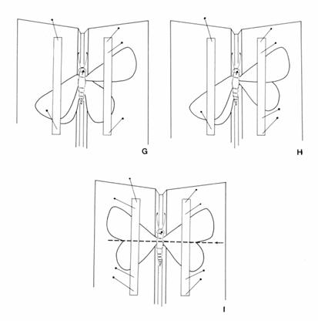
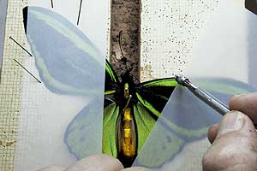
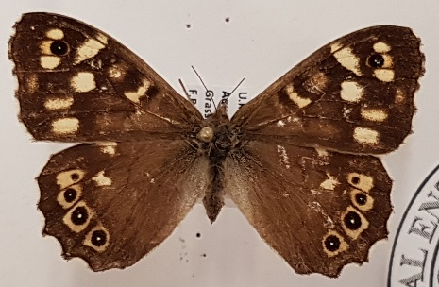
Lepidoptera setting
Large pin (size 3 / 4) through thorax, place body in groove of setting board or foam stack.
Spread wings carefully, using point of pin to push leading vein, secure with setting paper and brace pins around the wing.
Wings should lie perpendicular to the thorax.

Slide 15
Any questions?

Slide 16
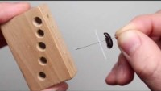
Video (4 min) How to pin an insect, Purdue

Slide 17
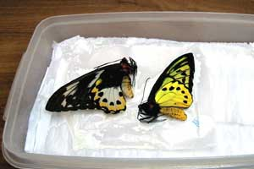
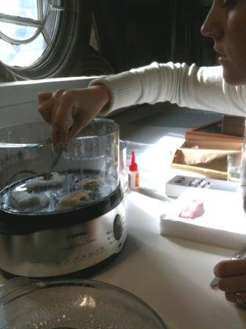
Relaxing/Rehydrating
If specimen is stiff /brittle then you need to soften them.
Create humid atmosphere on foam in box, or use steamer.
Antifungals in water: thymol, Milton Fluid.
Relaxing fluid, acetic acid can also be used.
NHM blog about beetles
https://www.nhm.ac.uk/natureplus/blogs/beetles/2011/11/05/steamy-beetles-or-whats-the-point.html

Slide 18
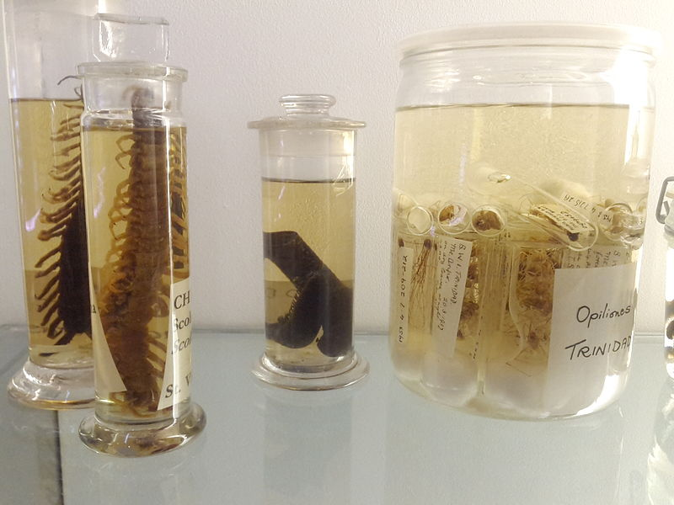
Wet ‘spirit’ collections
Specimens are stored in fluid (e.g. 80% IMS) in a sealed glass container, with labels.
Soft bodied specimens need dehydrating first (decreasing H2O in fluid).
Prepare in well ventilated area, and store in fire proof cabinet.
Specimens can lose colour and identifying characteristics long term.
Fluid should be topped up once a year.

Slide 19
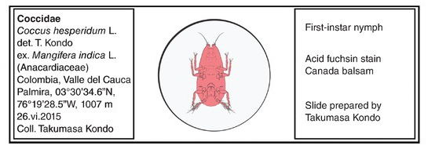
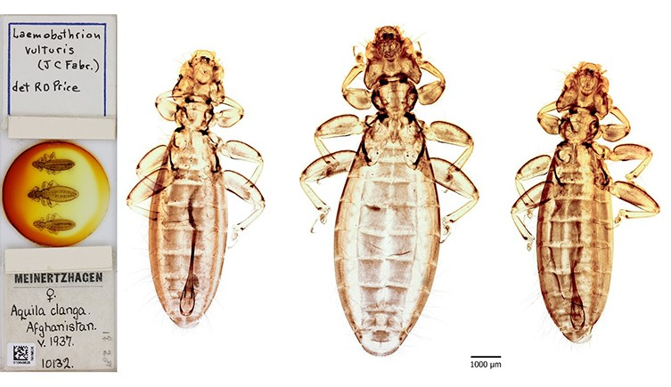
Slide mounting
Specimens are stored in fluid between a glass slide and coverslip.
Specimens are often ‘cleared’ with KOH or NaOH first to remove gut contents
Different reagents are used for temporary or permanent preparations.
Coverslips can be sealed onto the slide
Labels with Locality and Identity are on the side of the slide.
See Brown (1997), Brown (2005), Barbosa et al (2015) and Chick (2016) for details.

Slide 20
Other details
Particular characters are important for identification:
e.g. Bumblebees need to extract or pull out genitalia.
See Gullan & Cranston for details on how to preserve different insect groups and life stages.

Slide 21
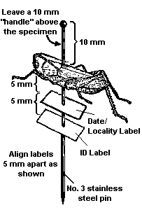
Labelling
1st level LOCALITY
COUNTRY, town, grid ref, altitude, vice county
Habitat, food plant
When 6.x.2015, time of day
Method, killing/preserving reagent
Collector(s)
2nd level (generally) IDENTITY/DETERMINATION
FAMILY
Genus species Authority, year
Determiner and date
Confirmer and date
Other levels – Sex, Collection accession or Specimen number, Redeterminations, Type labels.
Written or IDEALLY PRINTED (pt size 4).
Pinning block can be used for levelling.
Trim around text so least space used.
Have a look at the free EntomoLabels software: https://labels.entomo.pl/

Slide 22
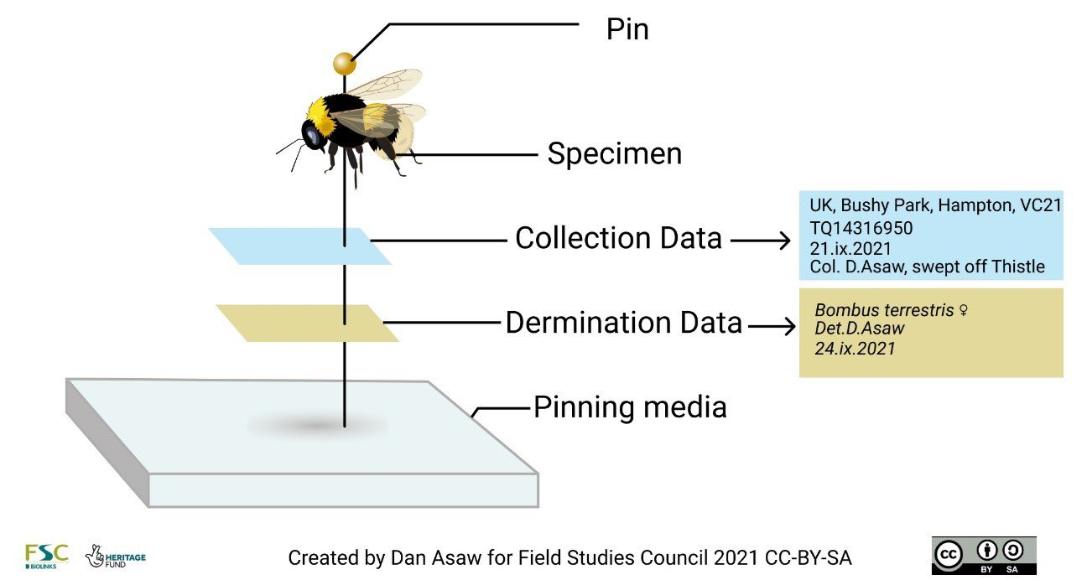
‘Anatomy’ of a pinned specimen

Slide 23
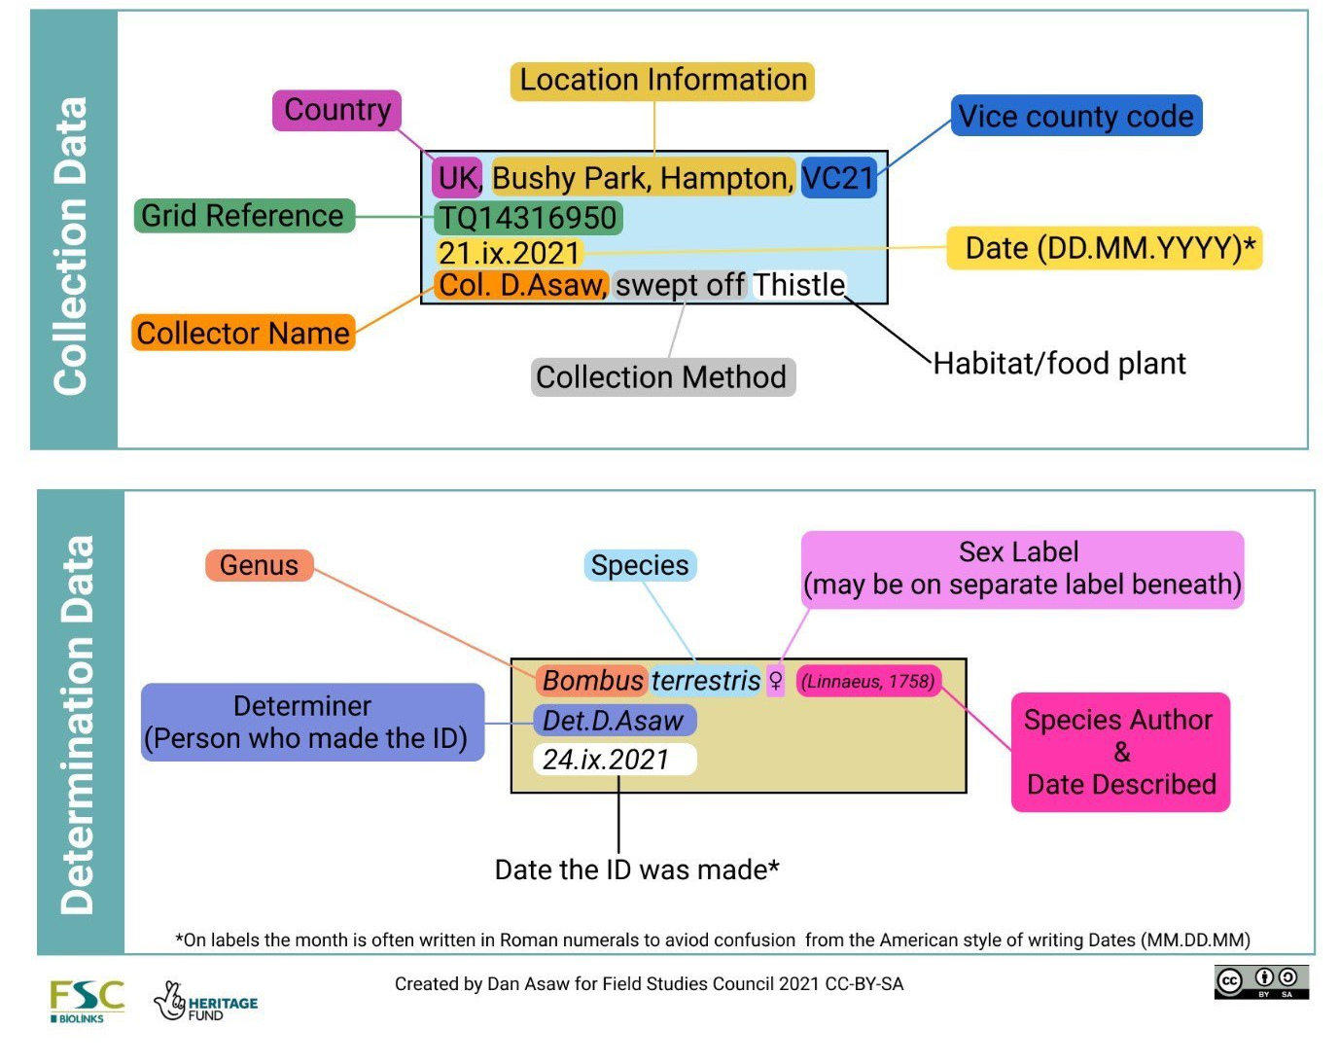
‘Anatomy’ of an entomological label

Slide 24
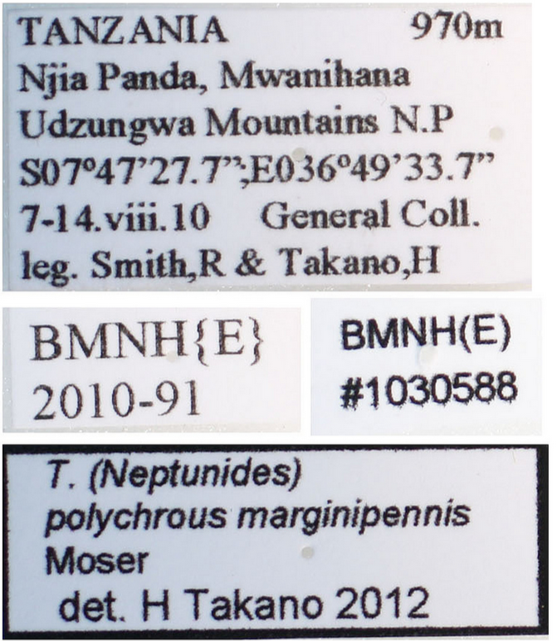
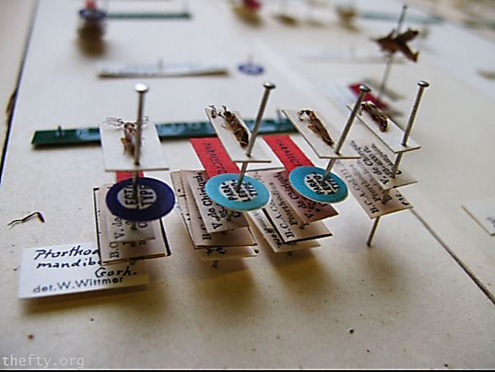
Some real labels
Labels = specimen history. NEVER REMOVE A LABEL!

Slide 25
Any further questions?

Slide 26
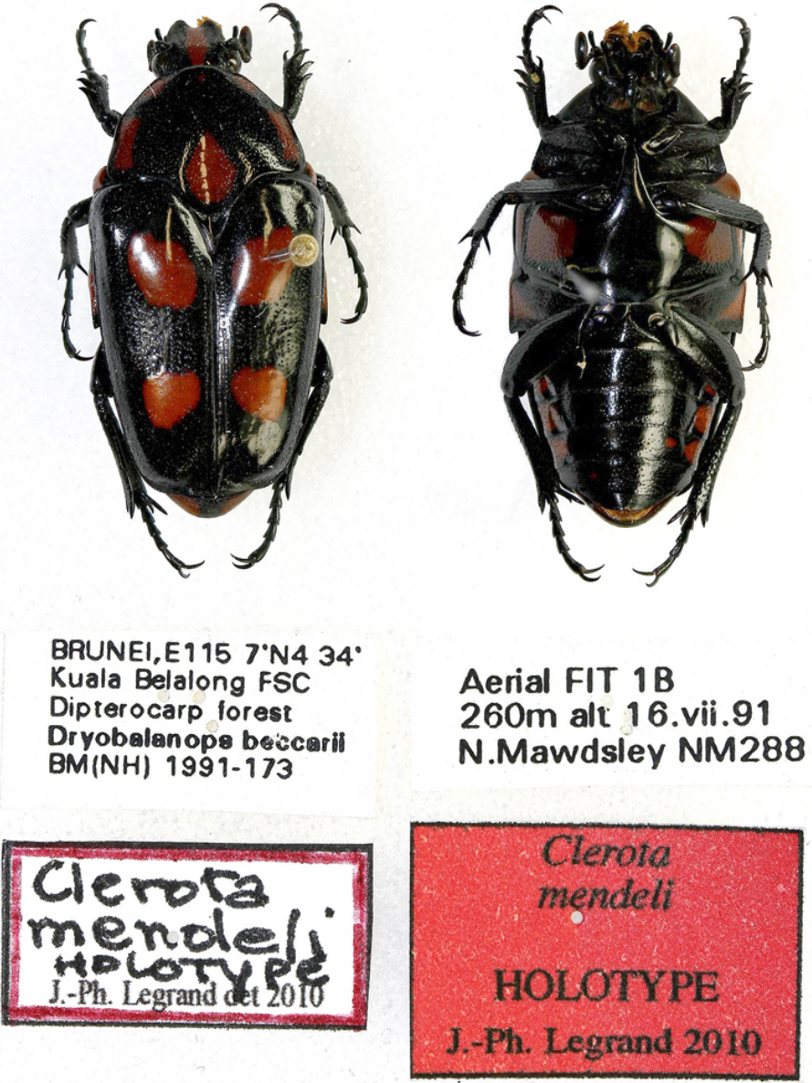
Type specimens
Representative specimen of a species, deposited in a Natural History Collection
Chosen by the ‘authority’, who described the species & published account
Holotype, paratype, lectotype….
See AES guide to types:
https://www.amentsoc.org/insects/glossary/terms/type-specimen
Legrand, J.-P. & Chew Kea Foo, S. (2010) Les Cetoniinae du Sabah. Collection ex Natura (Magellanes), 1, 1–127.

Slide 27
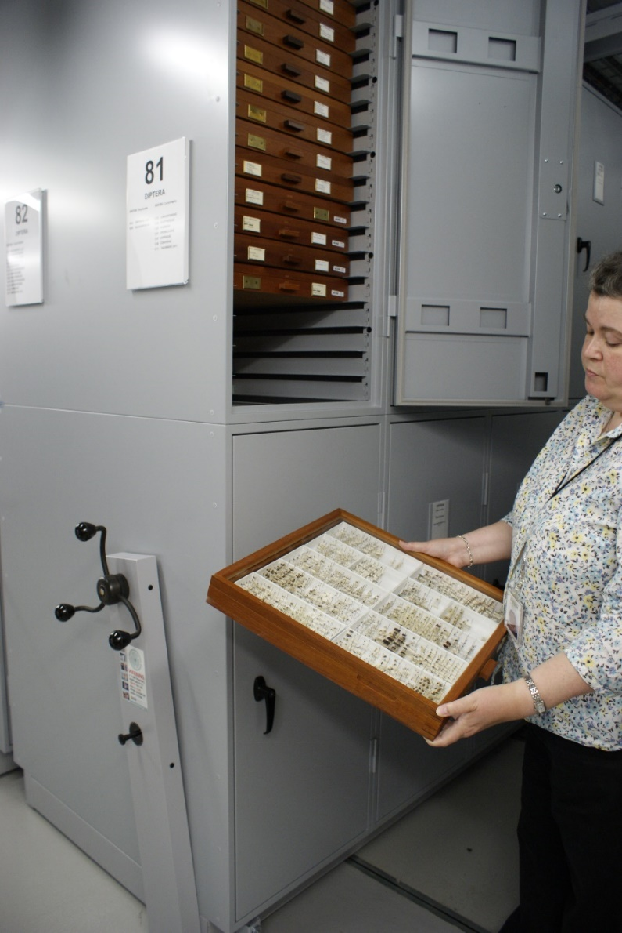
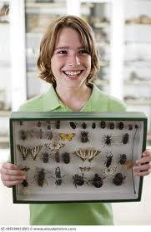
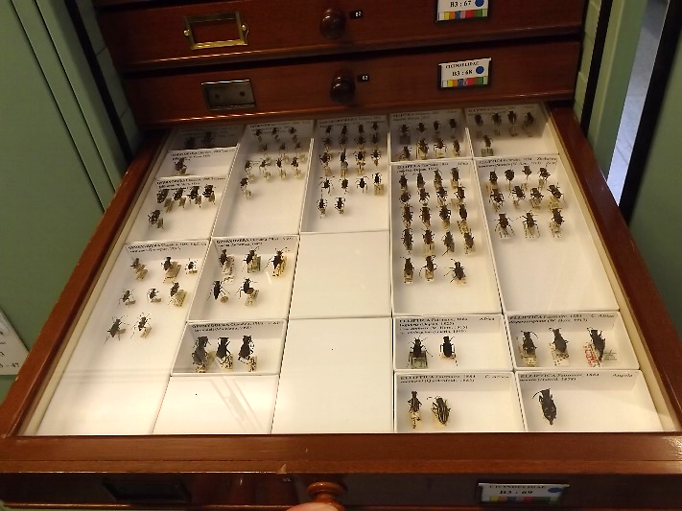
Storing a Collection
Containers
Boxes
Drawers
Cabinets
Pest control
Sealed containers
Temperature & humidity control
Insecticide – ‘Constrain’
See NATSCA guide, NHM pest guide.

Slide 28
Databasing
MS Excel spreadsheet
Emu database software emu.axiell.com
Specify database software specifysoftware.org
Keeping records of your specimens is also important for the CBD’s Nagoya Protocol:
“on Access to Genetic Resources and the Fair and Equitable Sharing of Benefits Arising from their Utilization (ABS)”
https://www.cbd.int/abs/about/default.shtml/

Slide 29
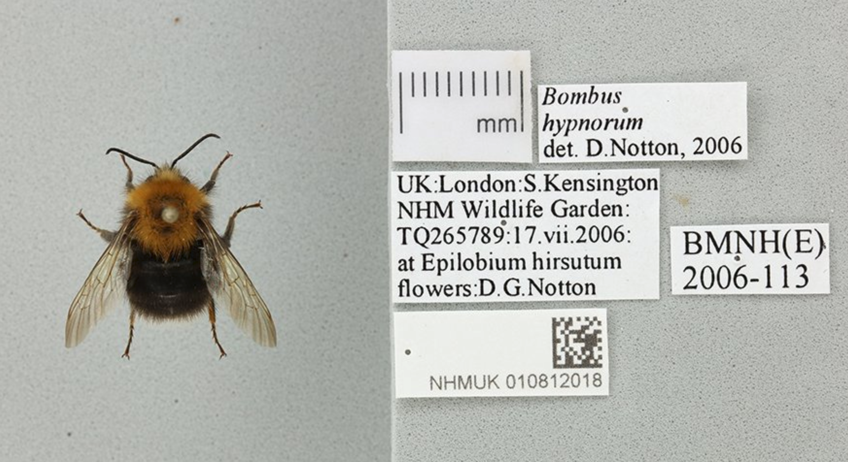
Digitising
Remove labels & take SLR stacked images

Slide 30
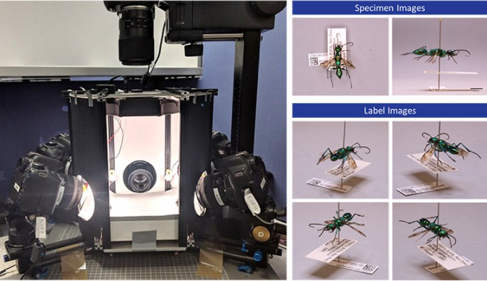
Angled Label Image Capture and Extraction (ALICE)
Newer method for digitisation
Multiple cameras take synchronised images
Developed at NHM London.
More about NHM Pinned Insect Digitisation
ALICE development publication

Slide 31
More on specimen digitisation
View the collection at NHM Data portal data.nhm.ac.uk
Follow the digitisation team on twitter/instagram @NHM_Digitise
See the Evolve magazine article on digitisation.
NHM is part of the wider European DISSCO project (Distributed System of Scientific Collections) www.dissco.eu
The ECN have an online course on digitising collections ‘BugFlow’ entcollnet.github.io/BugFlow/

Slide 32

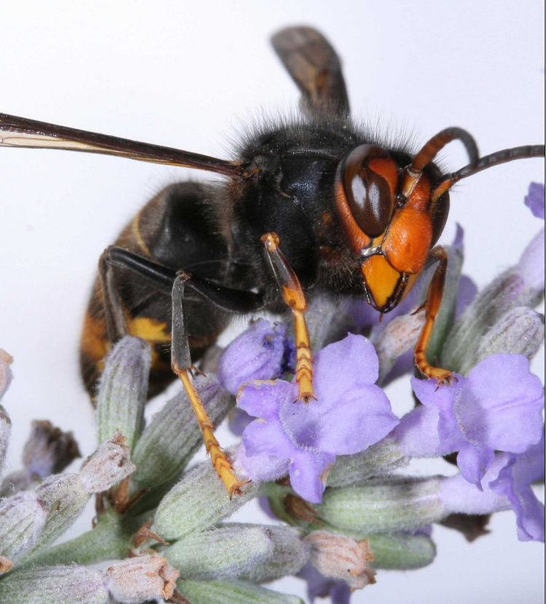
Recording insect species
What, where & when?
Best way is with smartphone app iRecord
(iNaturalist used abroad)
Citizen Science projects e.g. Big Wasp Survey, Flying Ant Survey
Non-Native Species Secretariat alerts
Quarantine (notifiable) pests (~ 30 species)
Preserved & labelled insects are evidence for biological records

Slide 33
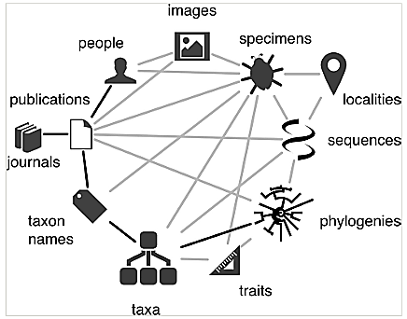
Within the Biodiversity knowledge graph
From Page R (2016) Towards a biodiversity knowledge graph. Research Ideas and Outcomes 2: e8767. doi: 10.3897/rio.2.e8767

Slide 34
Further information (pinning techniques)
Advice for each order: Gullan, PJ & Cranston PS (2010) The Insects. Pg 447-456
Cooter, J & Barclay, MVL (2006) A Coleopterist’s Handbook. Pg 315-336
Chandler, P (2010) A Dipterist’s Handbook. Pg 81-95
Betts, C (1986) The Hymenopterist’s Handbook. Pg 136 – 139
Hymenoptera course http://hymcourse.org/default.asp?action=Show_Archive
Great set of videos from UC Davis Entomology part 1 - 11: https://www.youtube.com/watch?v=mTKNiyi3CJE&list=ULEateTII2e6Y&index=2
Pinning step by step
http://www.insectcompany.com/main/howto.shtml
Free guide from Hillery Warner at NHM – see pdf

Slide 35
Further information (slide mounting)
Brown, P. A. (1997). A Review of Techniques Used in the Preparation, Curation and Conservation of Microscope Slides at the Natural History Museum, London. The Biology Curator, 10 ‐ Supplement, 1 ‐ 4. http://www.natsca.org/article/455
Brown, P. A., Boise, E. D. (2005). Procedures for Preparation and Conservation of Whole Insect Permanent Microscope Slide Mounts within the Department of Entomology, The Natural History Museum, London. NatSCA News, Issue 5, 25 ‐ 30. https://www.natsca.org/node/303
Barbosa, P; Berry, DL & Kary, CS (2015) Insect Histology: practical laboratory techniques.
Chick, A (2016) Insect Microscopy
Neuhaus, B; Schmid, T; Riedel, J (2017) Collection management and study of microscope slides: Storage, profiling, deterioration, restoration procedures, and general recommendations Zootaxa 4322 (1): 001–173 https://biotaxa.org/Zootaxa/article/view/zootaxa.4322.1.1
Quekett Microscopical Club www.quekett.org

Slide 36
Further information (equipment & people)
Collecting equipment www.nhbs.com
Pinning equipment www.watdon.co.uk
Cheaper but longer delivery: www.entosphinx.cz/en
Recent collection management book:
Huxley, R; Quaisser, C; Butler, CR & Dekker, RWRJ (2020) Managing Natural Science Collections: A Guide to Strategy, Planning and Resourcing. Routledge.
Overall preservation book:
Schorn, S (2021) Specimen-making and Preservation of Invertebrates. Edition Chimaira. (£14.99 at NHBS)

Slide 37
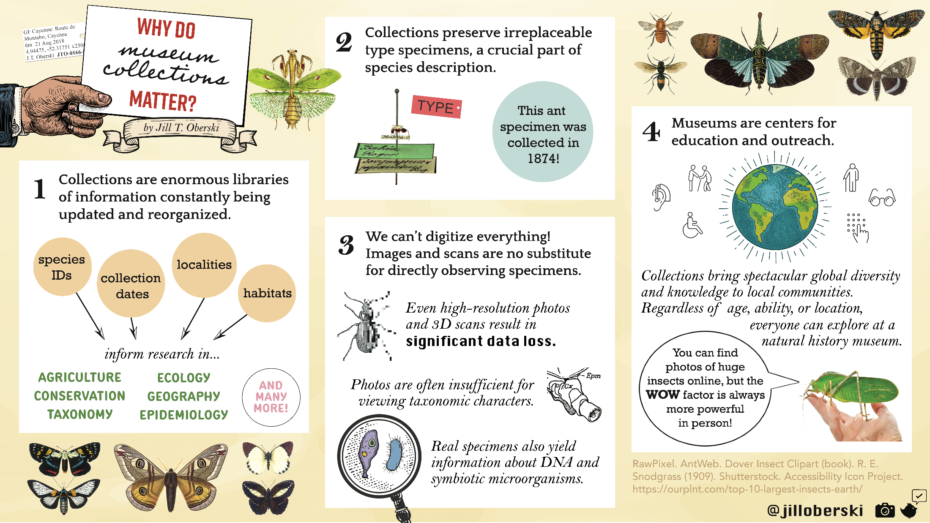
A great infographic…
Infographic on museum collections
By Jill Oberski in November 2020, for the Entomological Society of America annual conference

Slide 38
Thank you
Francisca Sconce
fran@royensoc.co.uk
@FranciscaSconce
www.royensoc.co.uk

